Slide 1

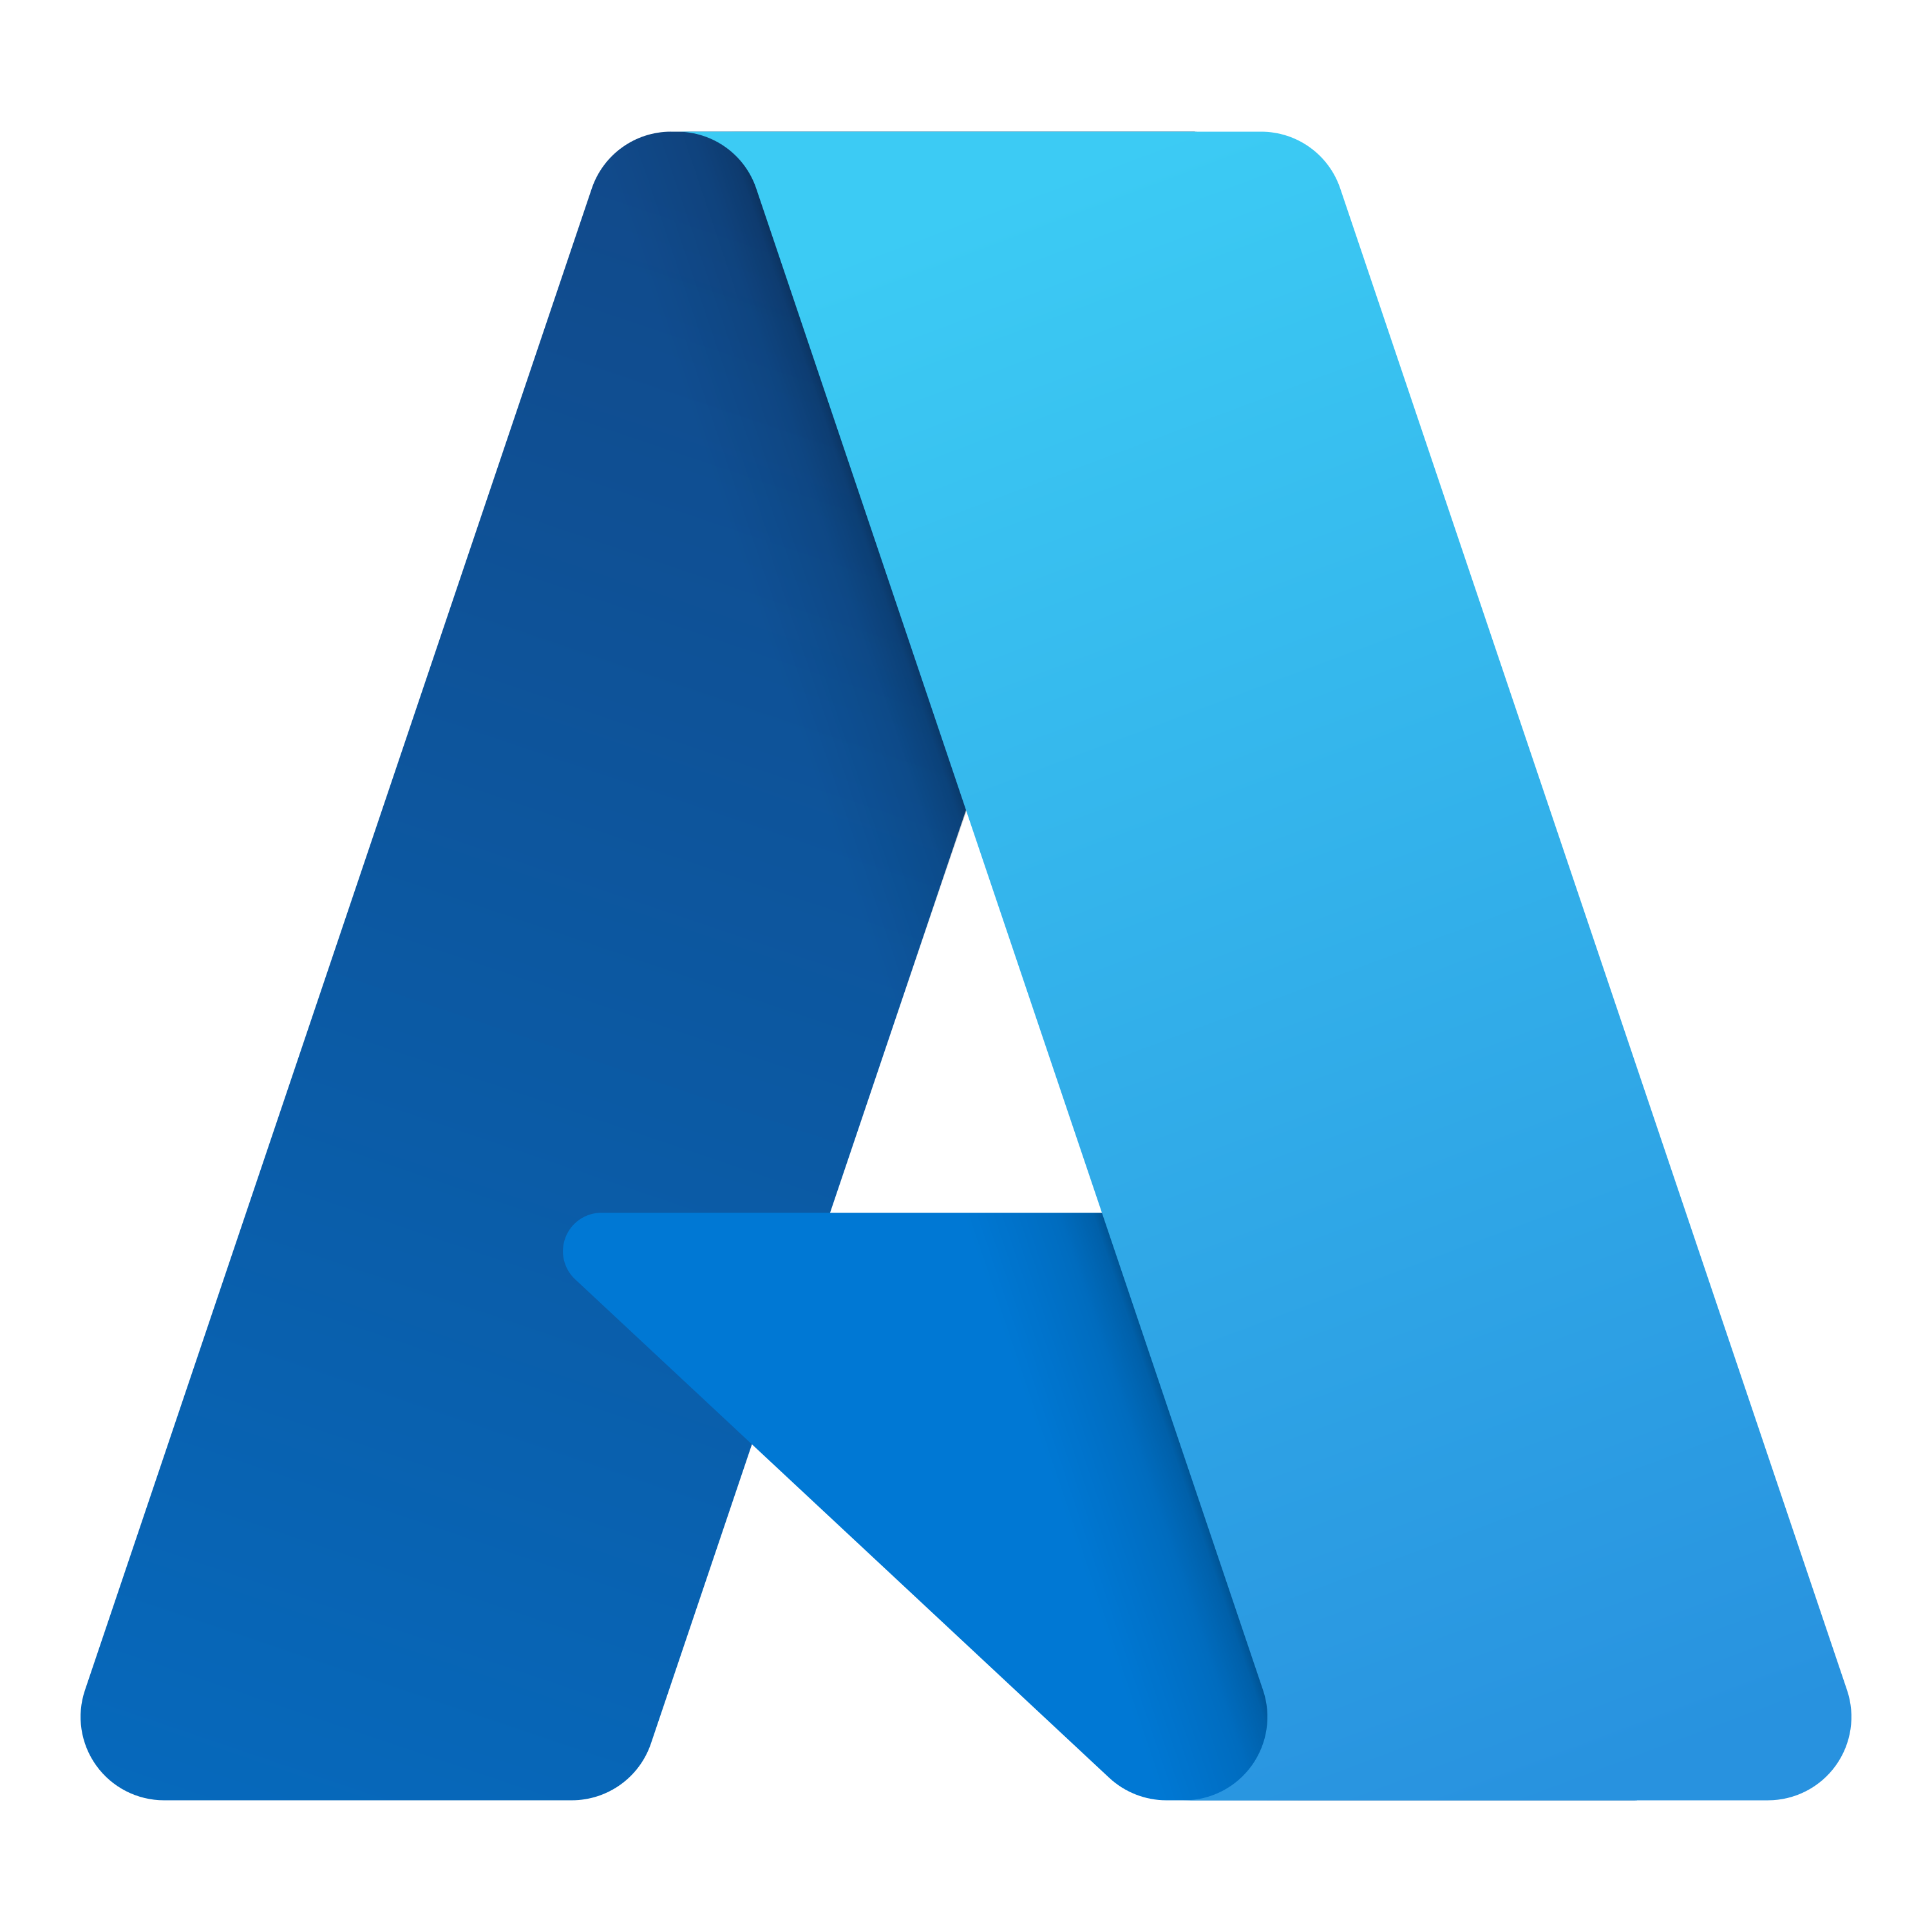
Building Cloud Native Applications with Dapr and Radius on Azure
Will Velida
Lead Software Engineer and Azure MVP
bsky.app/profile/willvelida.com

Slide 2

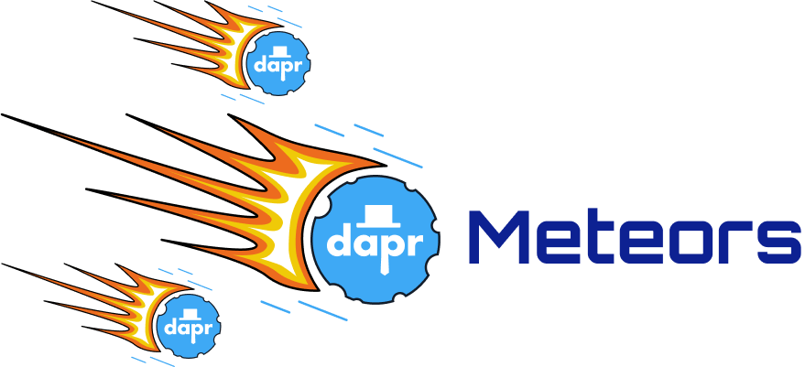
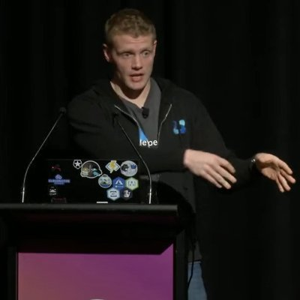
$ whoami?
Lead Software Engineer at Mantel Group.
Microsoft Azure MVP based in Melbourne.
Dapr Meteor: https://dapr.io/community/program/
Community Organizer.
Public Speaker.

Slide 3
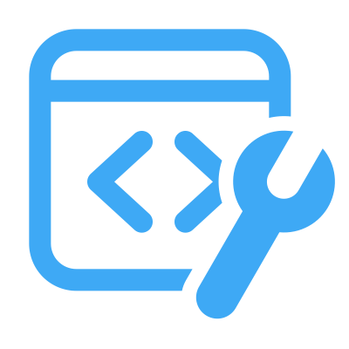
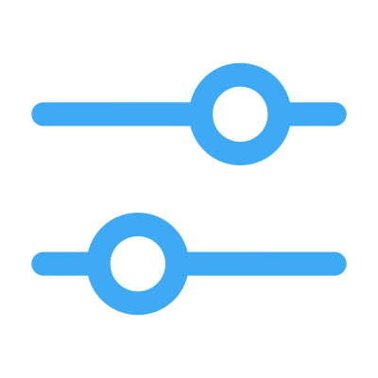
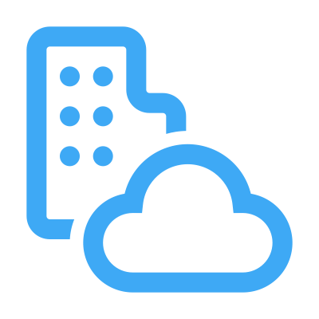
What’s holding back distributed app development?
Limited tools and runtimes to build distributed applications
Runtimes only target specific infrastructure platforms with limited portability
Runtimes have limited language support and tightly controlled feature sets
Notes:
So I talk to a lot of folks about building distributed applications, and there’s a few common challenges that they all face
First is there’s a limited amount of tools and runtimes to build applications, and there’s only a few options available to you, depending on where you deploy your applications.
And depending on the platform that you’re targeting, there may be a limited amount of support that your language of choice has (Azure Functions, C# vs Golang)

Slide 4
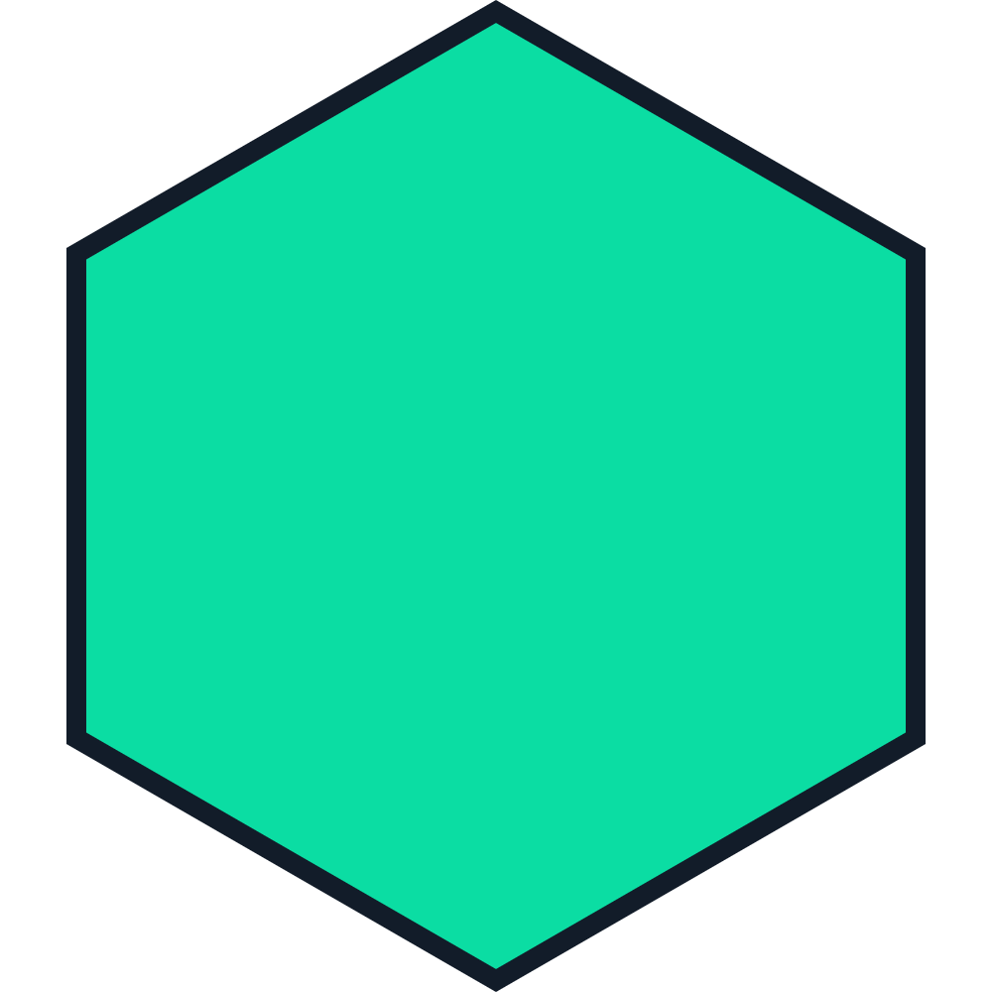
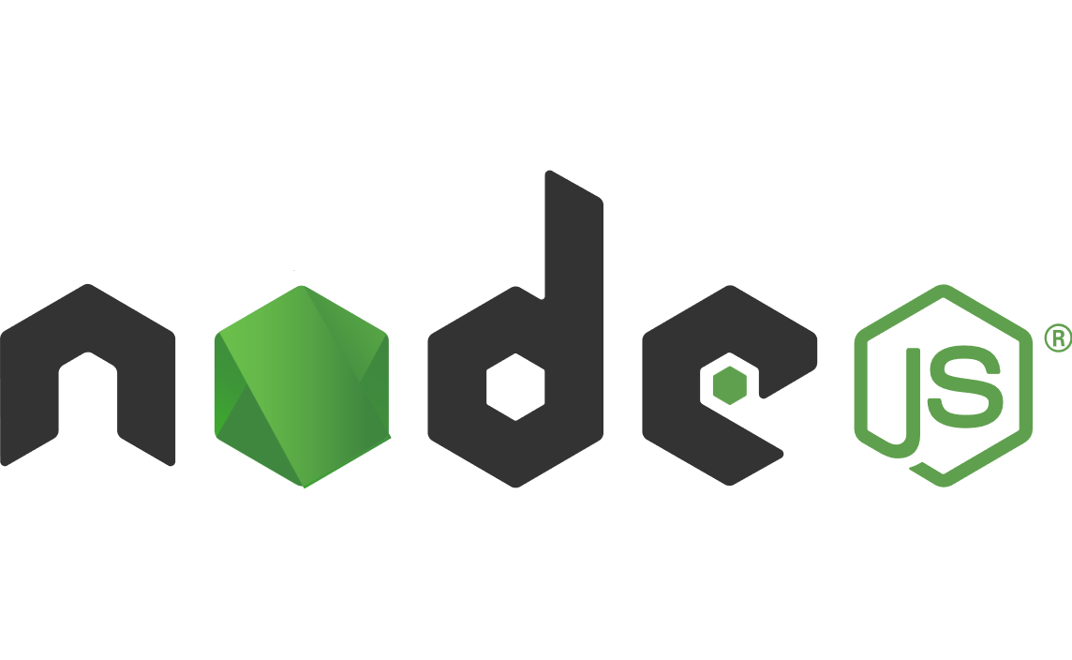

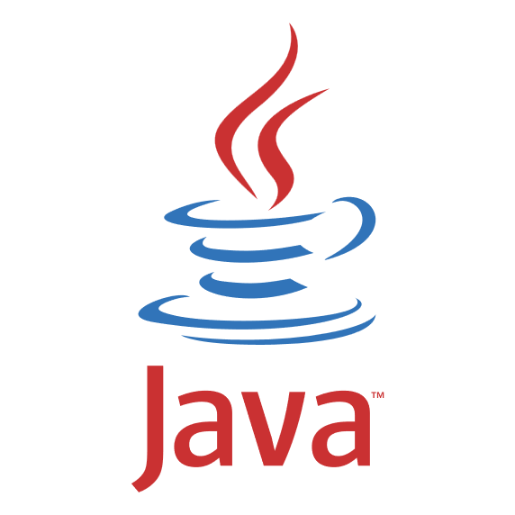
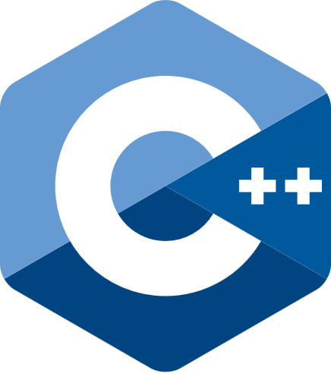

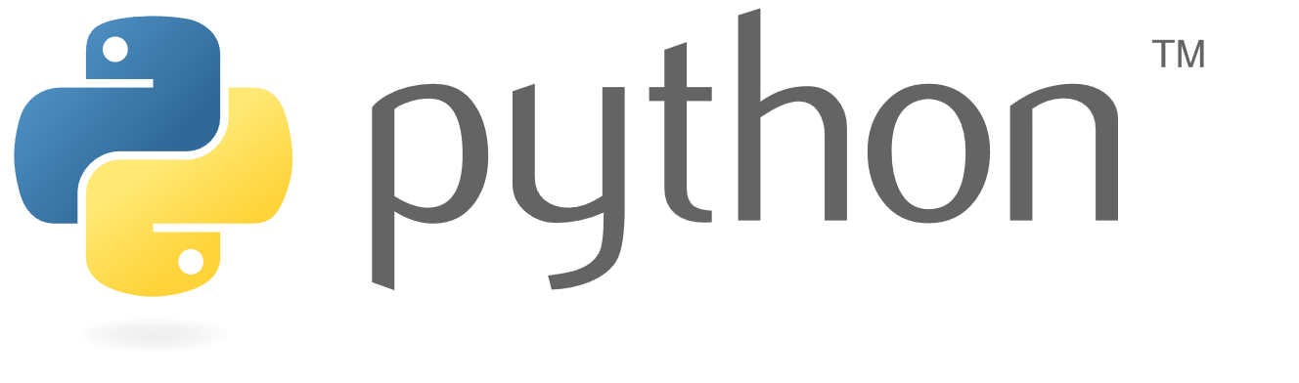

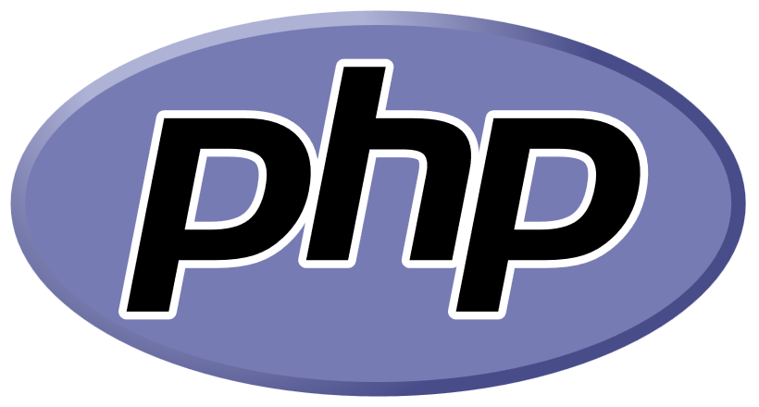
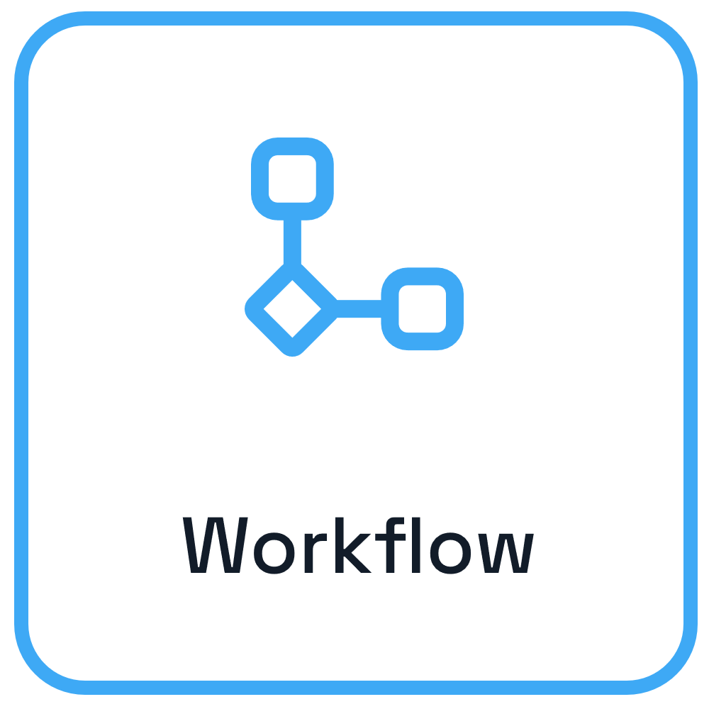

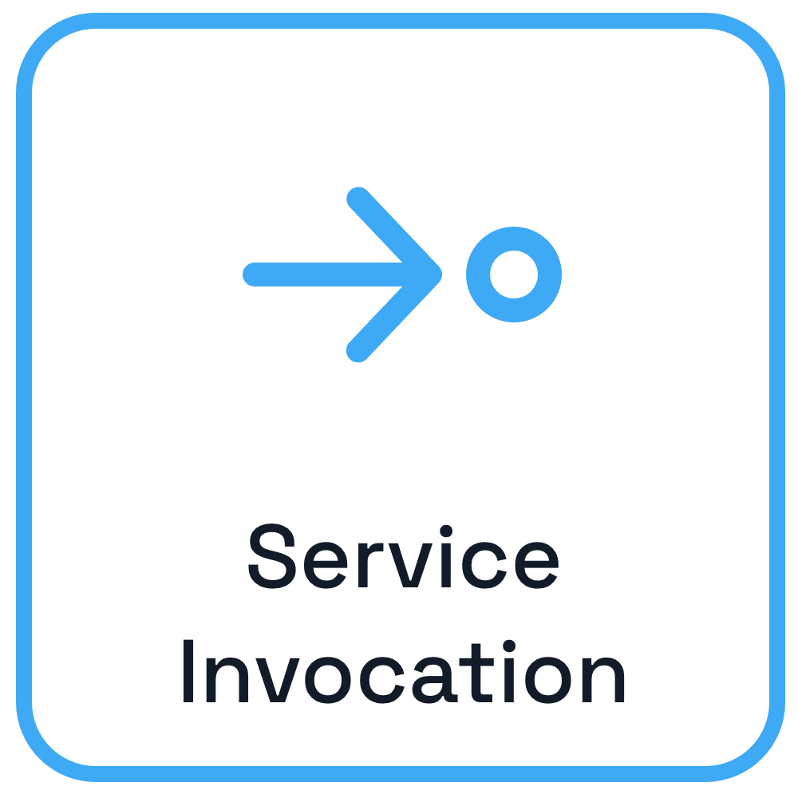
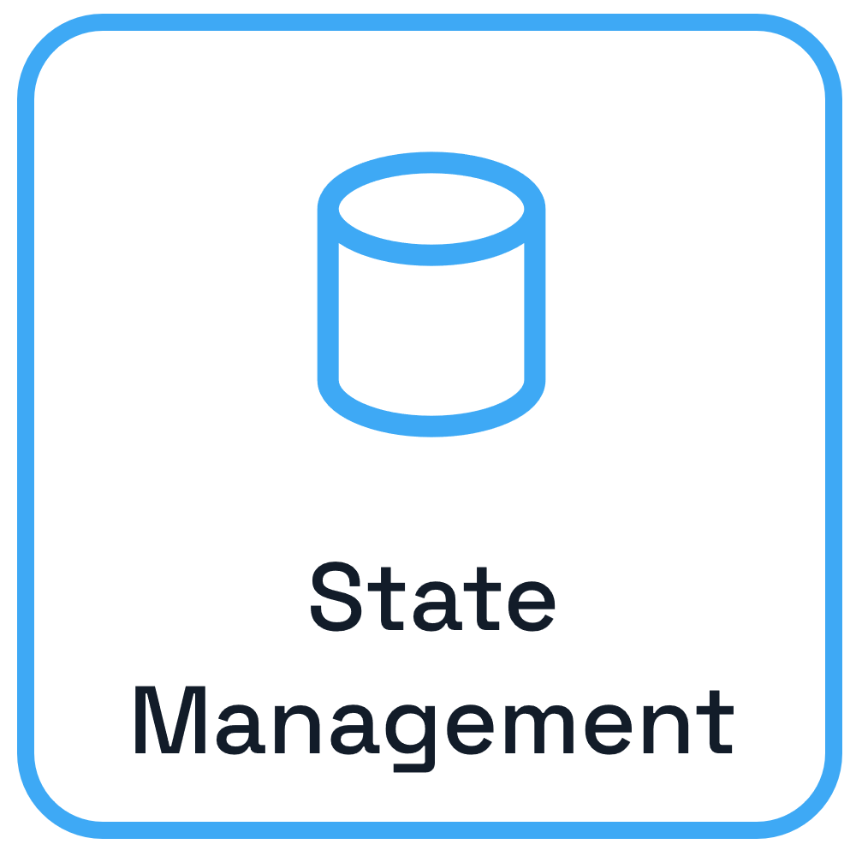
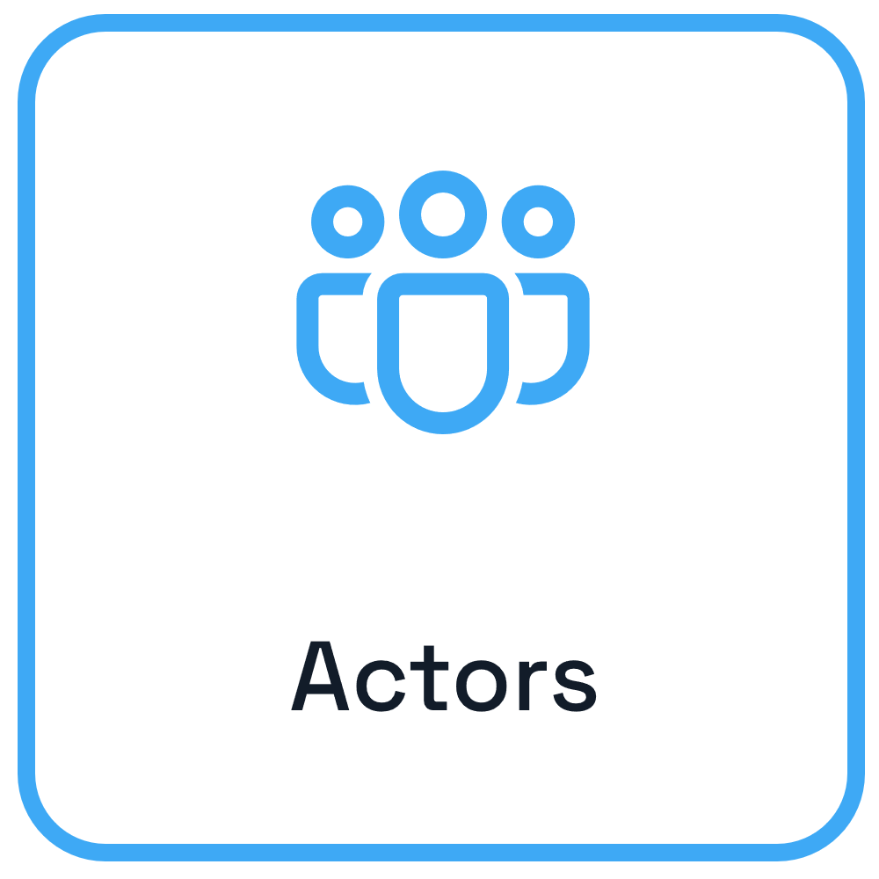
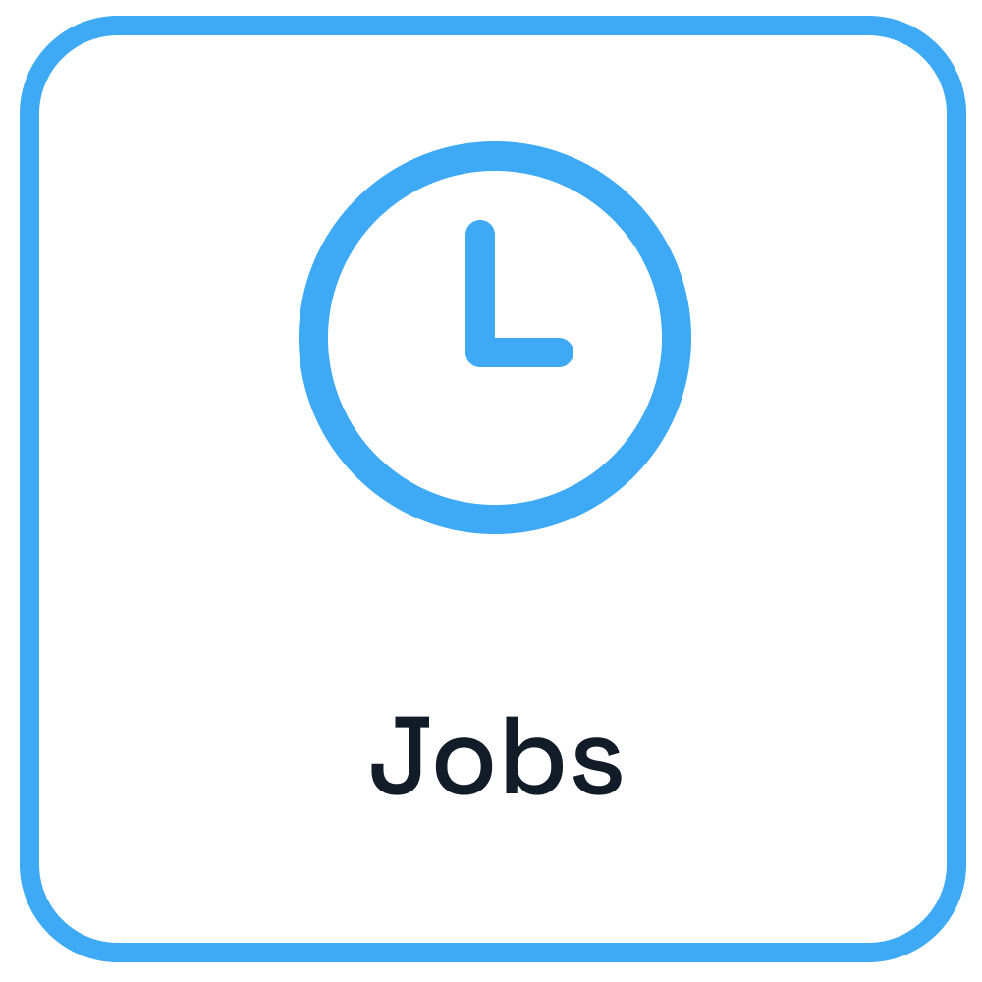
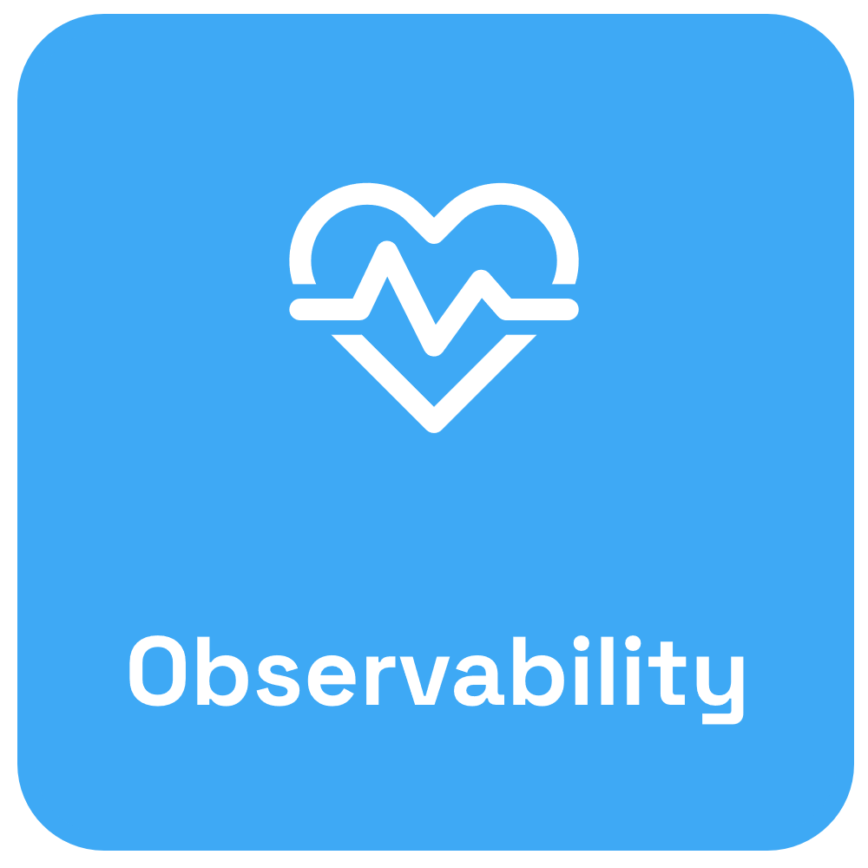

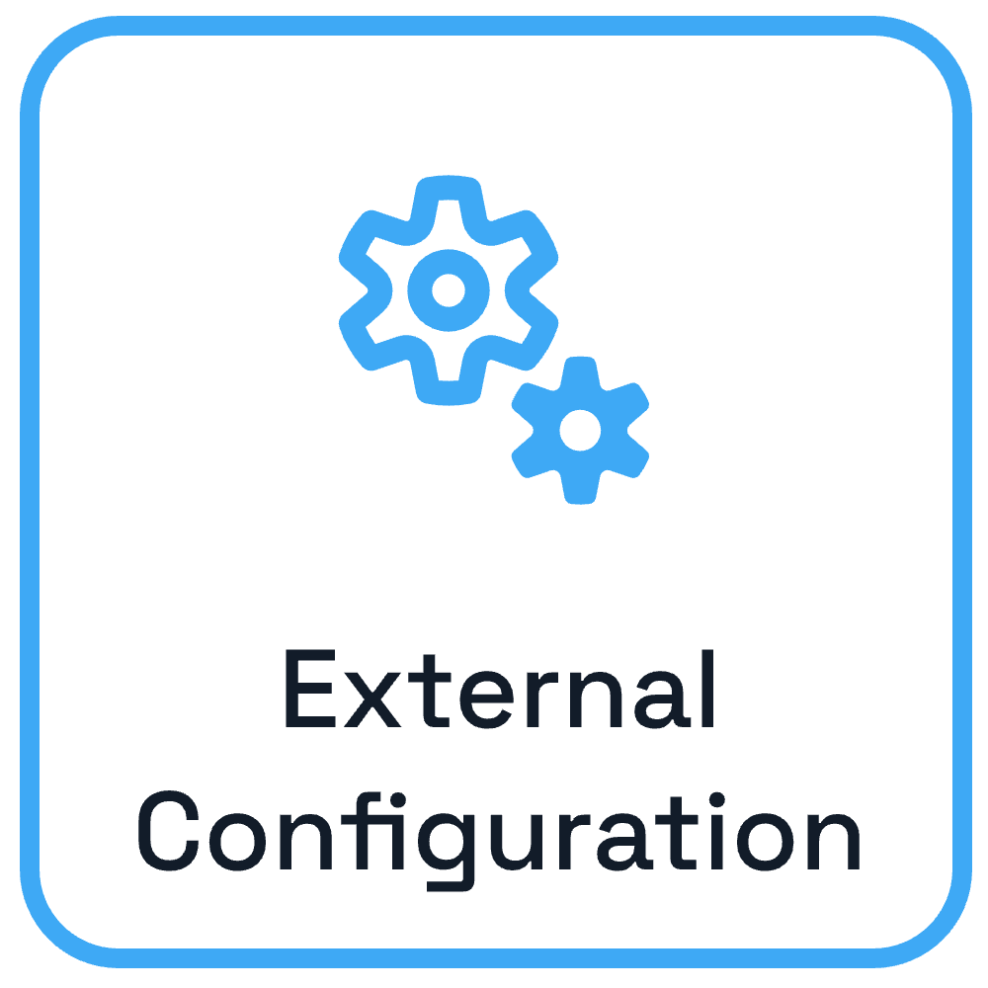

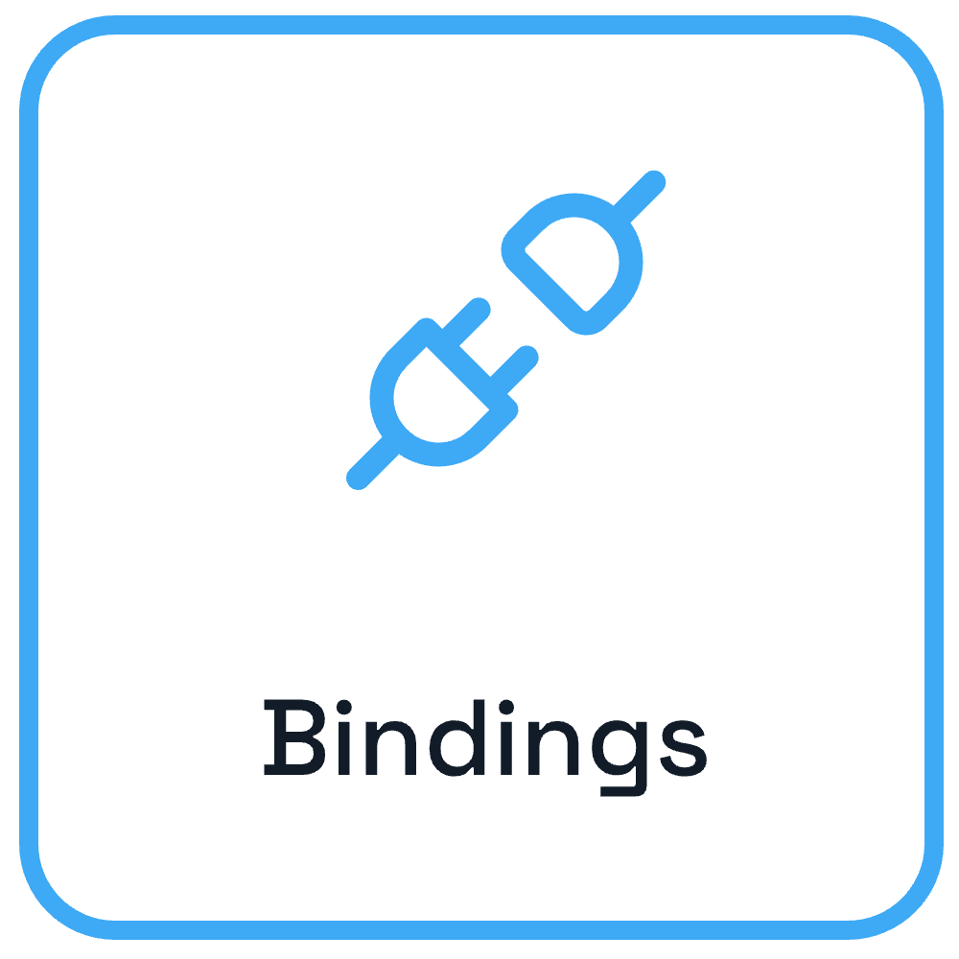
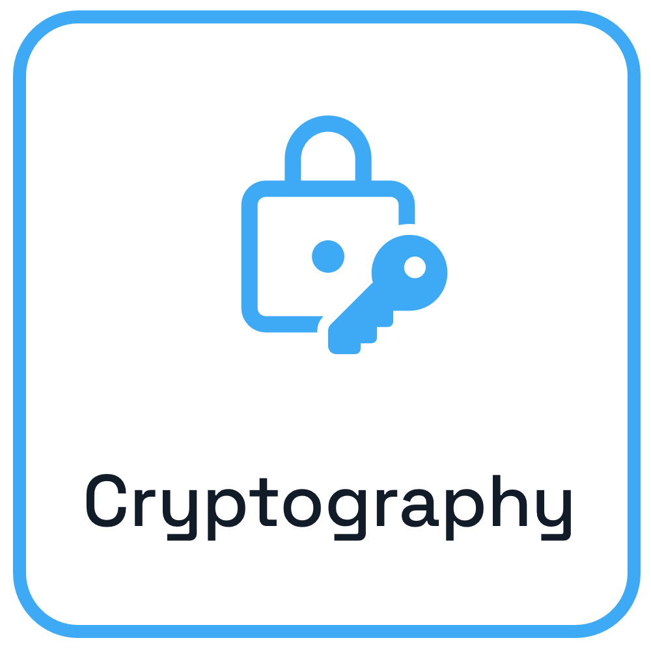
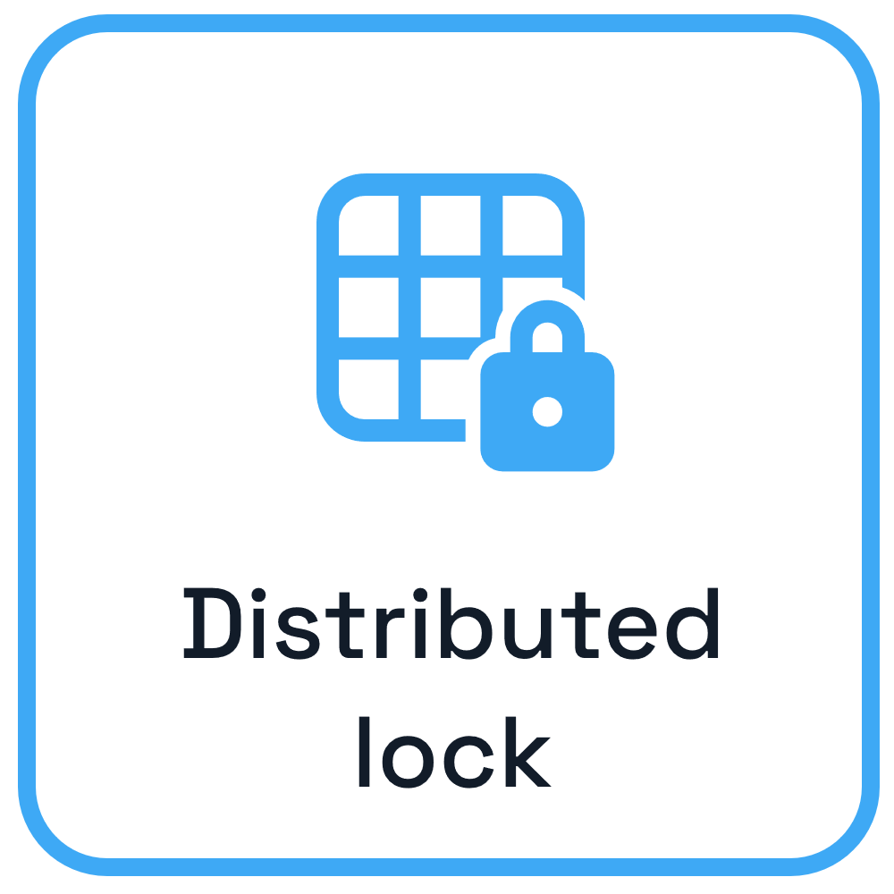
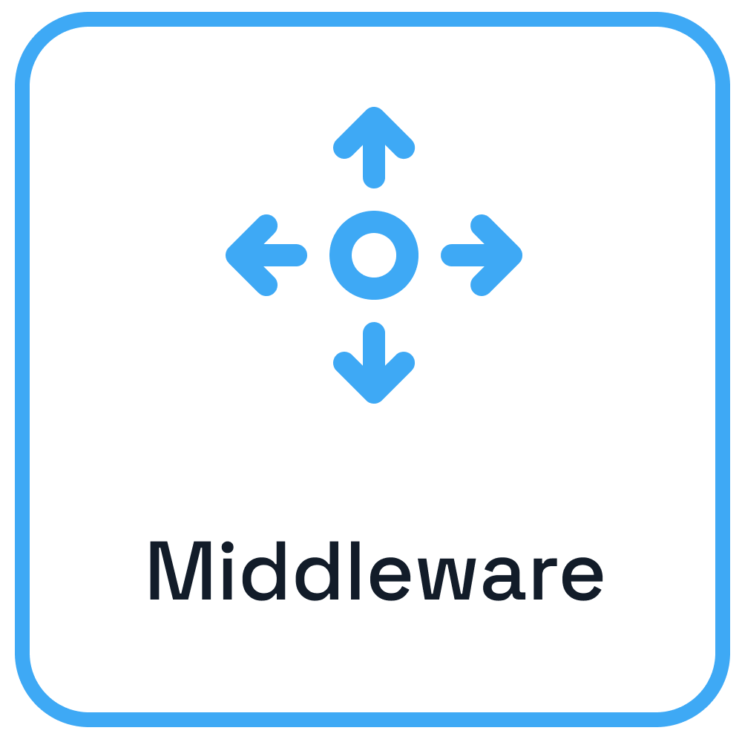
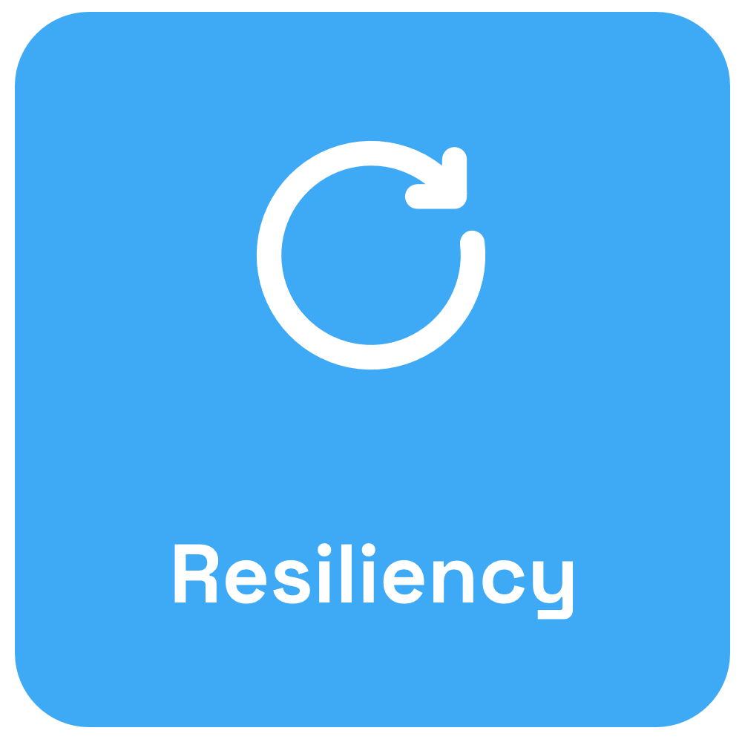
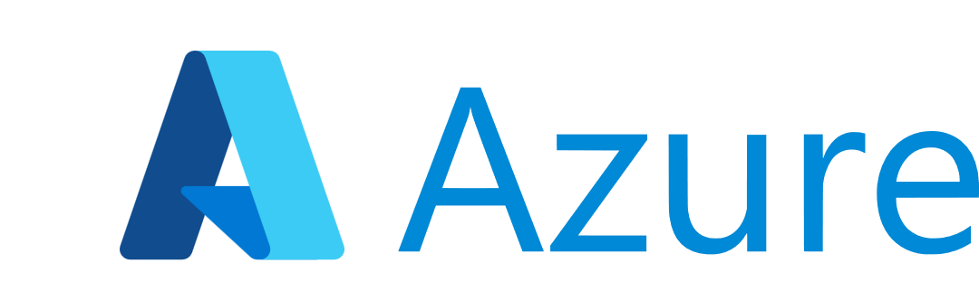

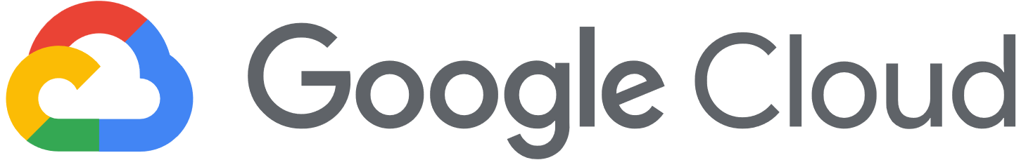
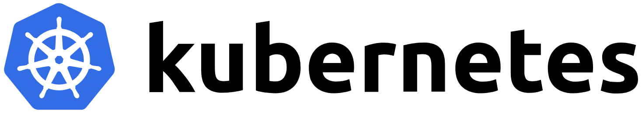
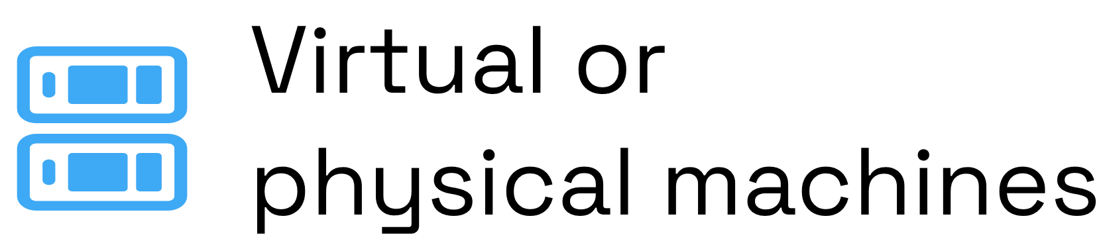
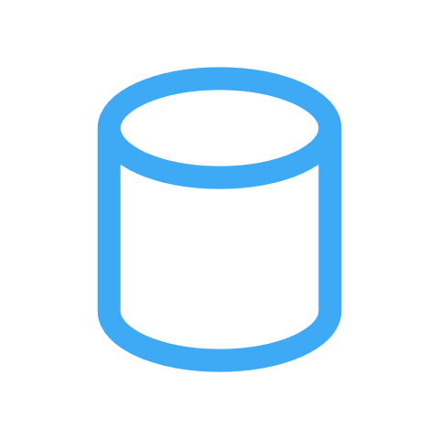


Dapr from development to hosting
Use any language or runtime
App
HTTP/gRPC
Host on & integrate with any cloud or edge infrastructure
Databases
Message Brokers
Services
Notes:
So this is where Dapr (Distributed Application Runtime) comes in.
No matter what language we’re developing our microservices with, Dapr provides a set of building blocks, which address common challenges in building resilient, microservice applications, while codifying best practices (such as built-in retries, circuit breakers, distributed tracing etc), so you don’t have to be an expert in developing distributed systems just to use Dapr
So with these consistent APIs, there’s a simpler method of deploying our applications without conforming to a specific cloud provider.

Slide 5
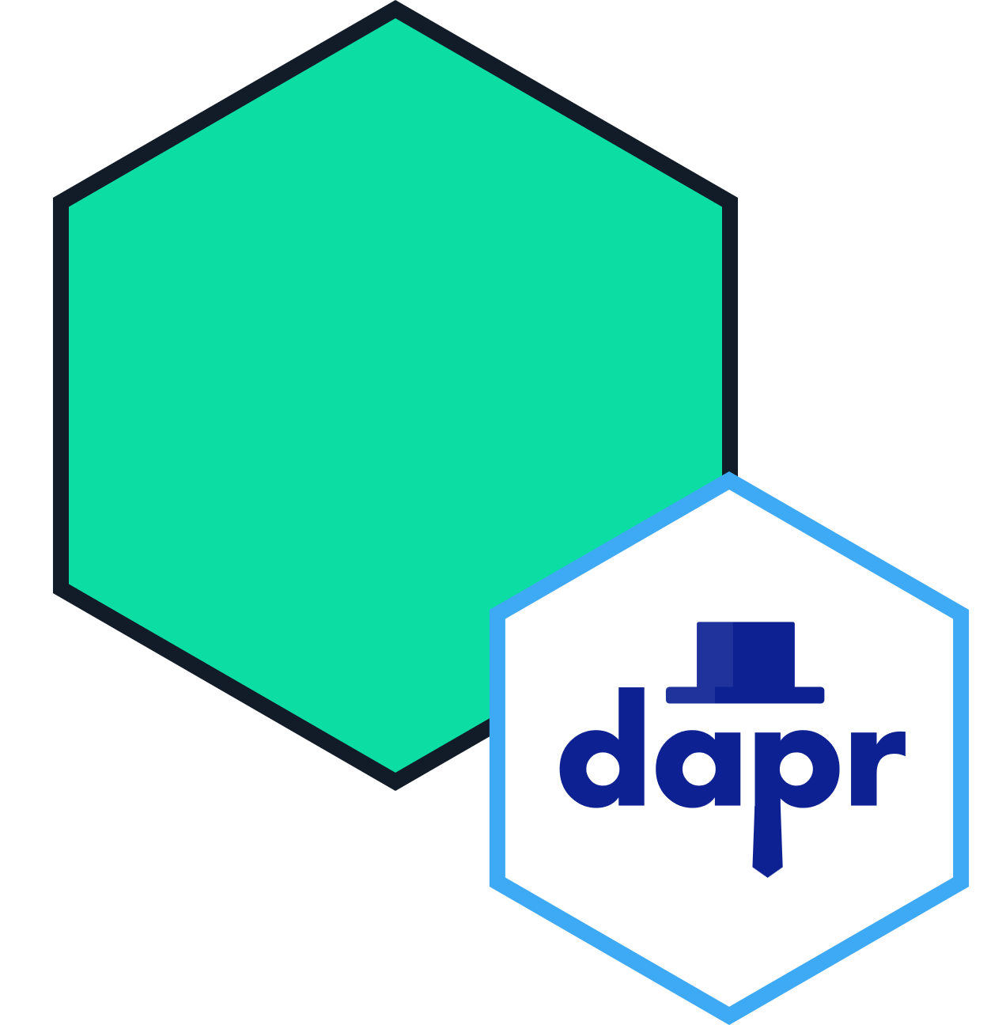
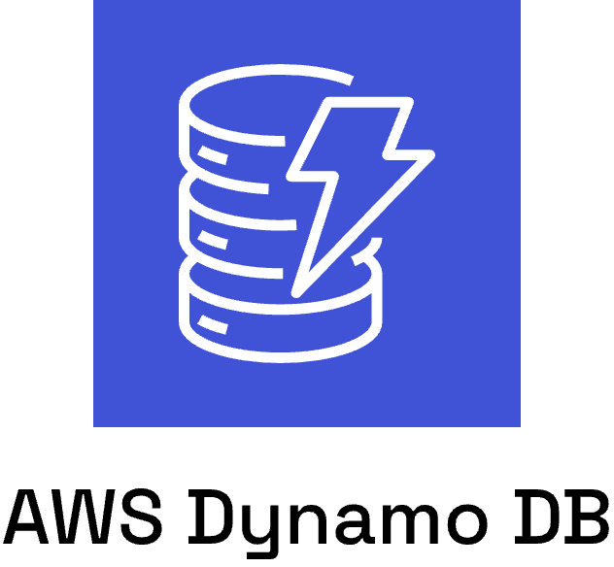
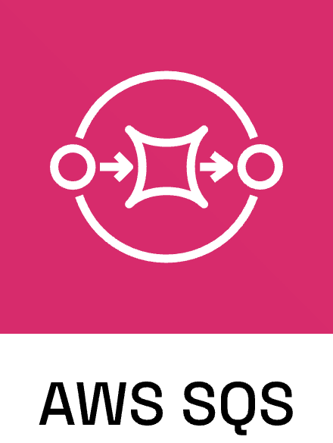
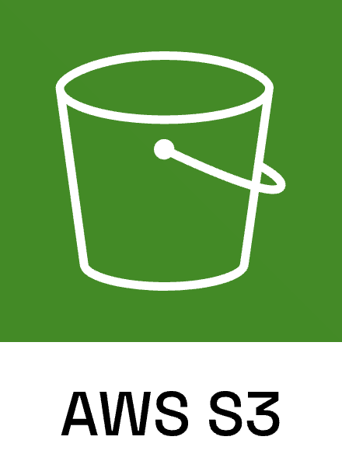

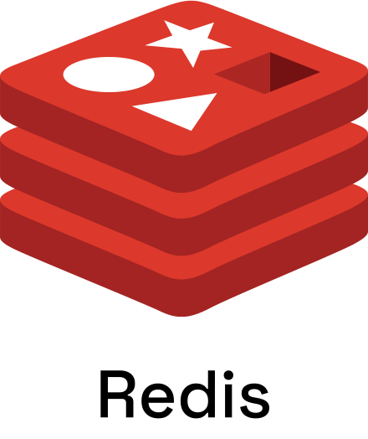

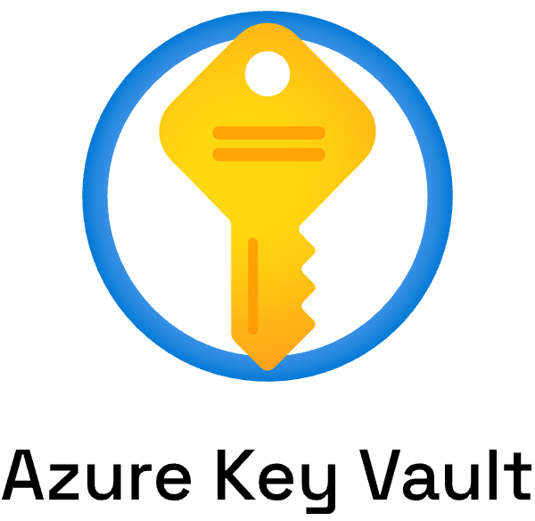
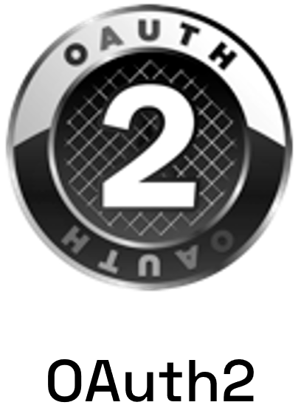
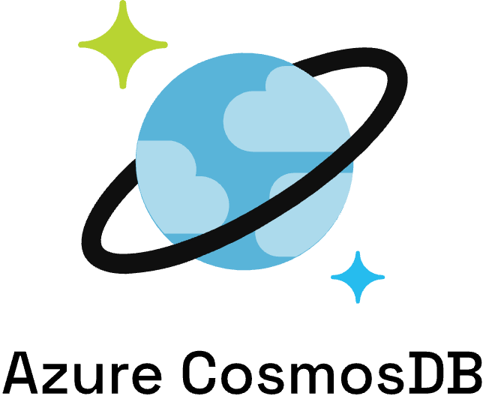
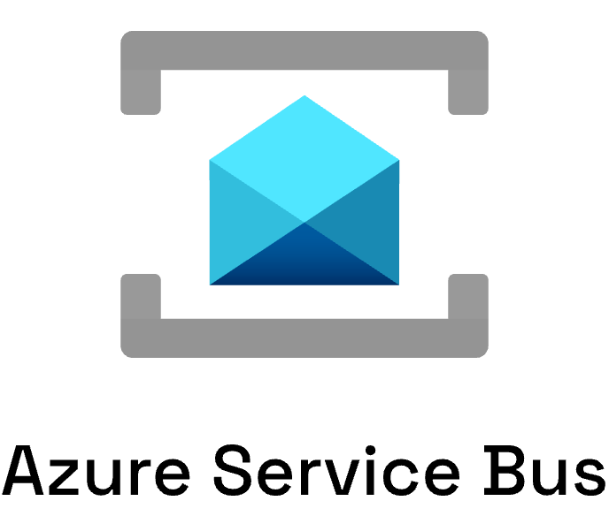
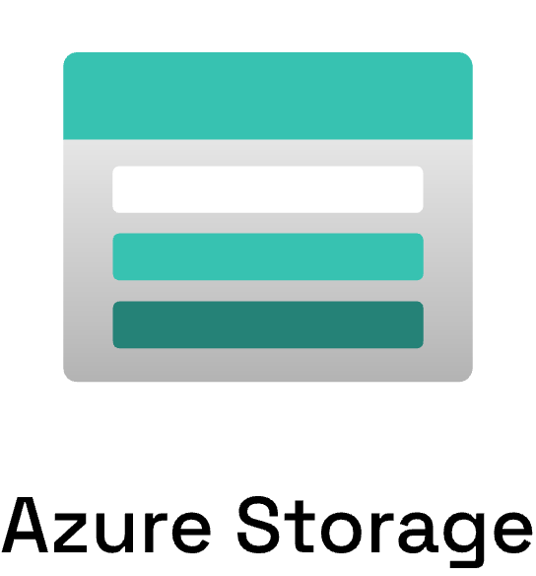
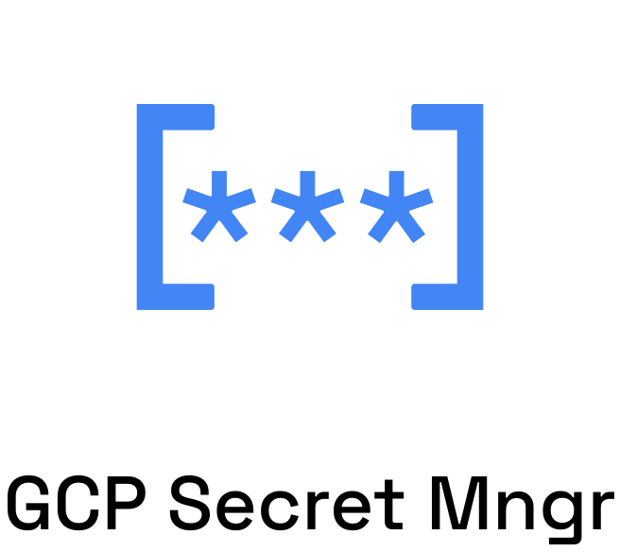
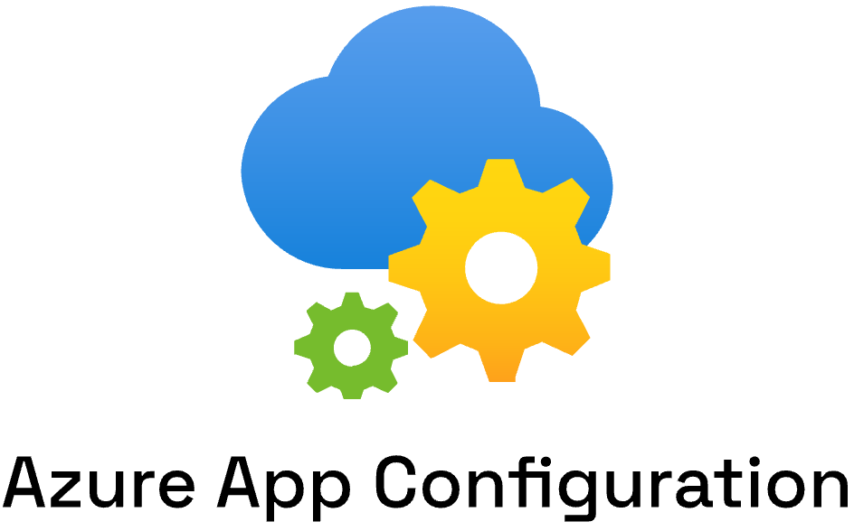
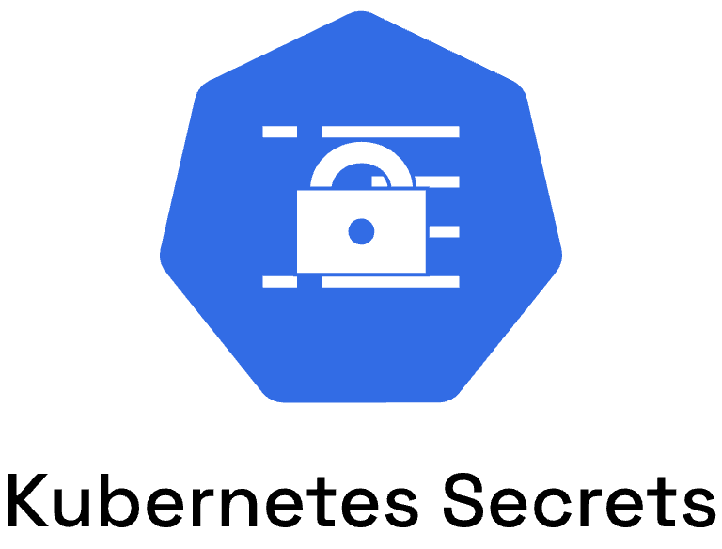
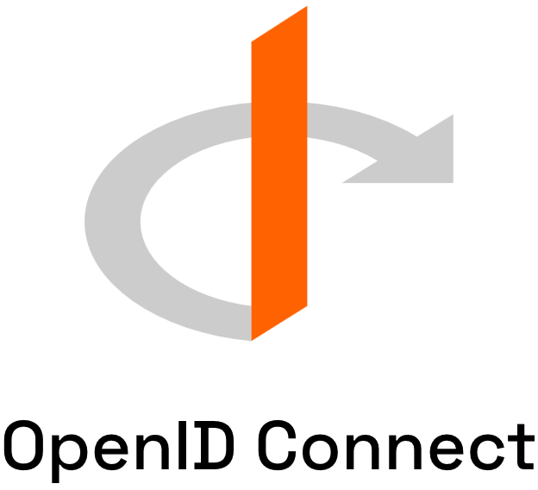

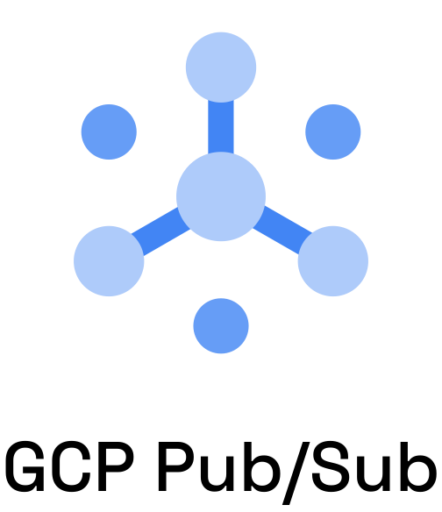
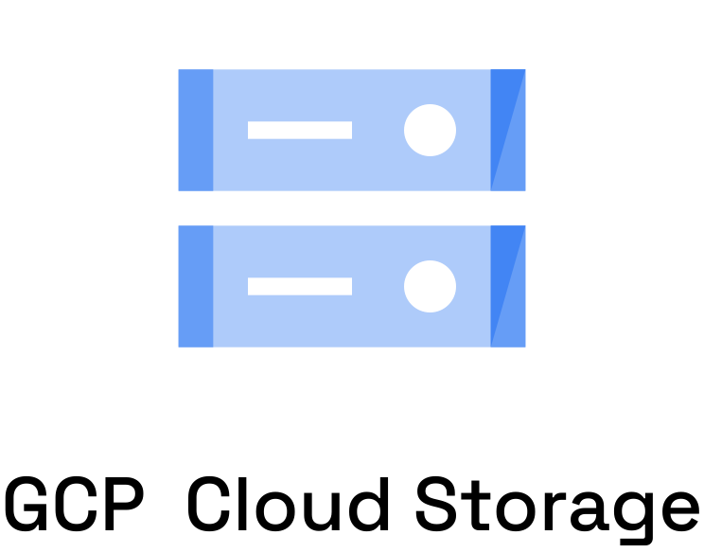
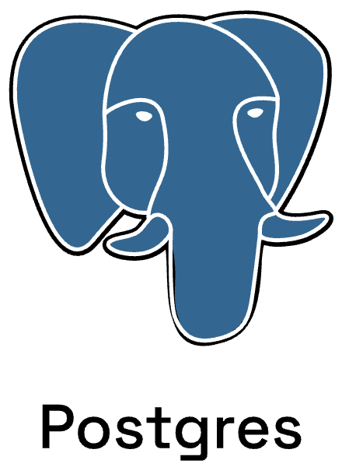
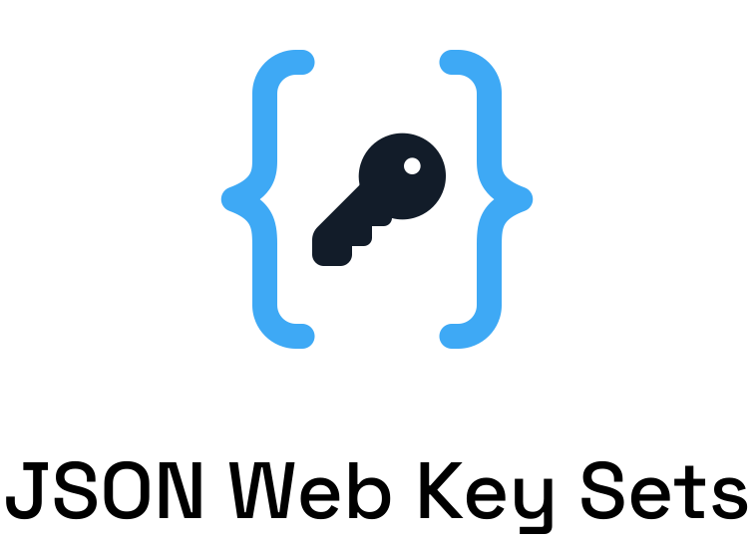
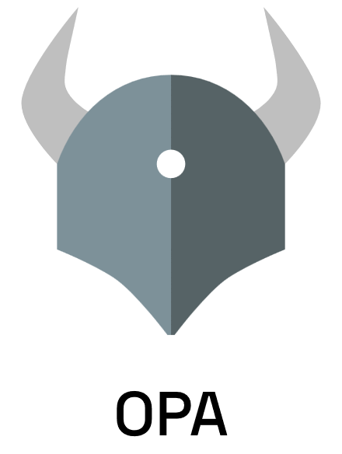
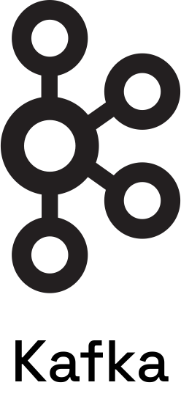

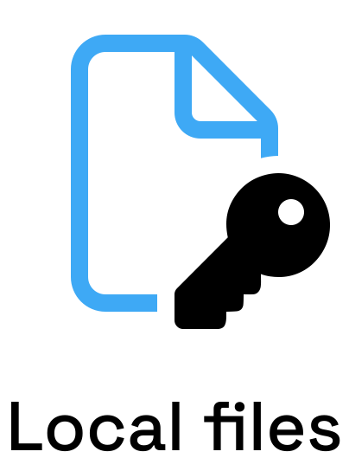






Dapr components
App
Notes:
These different building blocks expose a public API that we call from our code, so it doesn’t matter whether we’re using resources such as Azure Cosmos DB for state management, Service Bus for PubSub etc. in our application code, we can use a consistent api without having to worry about a specific SDK

Slide 6



Why is building and running Cloud Native apps hard?
Complex architectures
Cross-platform portability
Enforcing
best-practices
Troubleshooting
experiences
Notes:
But that doesn’t mean we can forget about the underlying resource. We still need to manage our infrastructure effectively, with respect to factors like security, networking, compliance. We still need to ensure that we enforce best practices, while enabling our developers to move fast, and relieve them from the responsibility of managing the platform themselves.

Slide 7
Cloud-native application platform
that works on any cloud
Notes:
“Radius is an open-source, cloud-native application platform that enables developers and operators to develop and collaborate on cloud native apps across public and private clouds”

Slide 8
Team
Collaboration
Infrastructure Recipes
Application
Graph
Cloud
Neutral
Radius Application and Environments allow developers to work with operations on application definition + delivery
Swappable infrastructure with popular IaC tools that follows org best practices and IT policy
by default
Understand
how services and infrastructure in an application are interconnected
Deploy across development, on-premises, and cloud environments with a consistent experience
Notes:
Radius is designed to enable platform engineers and developers to collaborate on building cloud-native applications. The abstraction unit here is what we call recipes, which are swappable pieces of infrastructure that follow your organization’s best practices and configuration by default.

Slide 9












Cloud-native applications
containing
Team
Collaboration
Infrastructure Recipes
Application
Graph
Cloud
Neutral
Any cloud or edge infrastructure
Notes:
So no matter where we are developing and deploying our cloud native applications, our developers define our application in a graph, and include recipes that abstract the underlying cloud resource, which relieves them from having to know the details of the cloud that they’re deploying to.

Slide 10







Recipes
Azure
SQL DB
Container
SQL DB
AWS RDS
SQL Edge
Container
Services access consistent connection strings and values
Infrastructure automatically deployed and configured
Leverage your existing IaC templates
Bicep
Extensible…
Notes:
- Recipes enable a separation of concerns between IT operators and developers by automating infrastructure deployment.
- Developers select the resources they want in their apps, and Platform Engineers will codify in their environment how these resources should be deployed and configured.
- So when a developer deploys their application and its resources, Recipes automatically deploy the backing infrastructure and bind it to the developer’s resources.
- Currently, recipes support both Bicep and Terraform. You can use Recipes that Radius provides, or you can create your own custom recipes.

Slide 11

Notes:
So in this example, I’m building an application and in that I want to use a cache. As a developer, I can define in my Radius application that I want to use a cache, so I can define that as a resource in my app.
What IT Operators and Platform Engineers will do, is codify how this cache should be deployed and configured. So in this example, this cache will be deployed onto Azure. We’re integrating it into a VNET, so we need a private endpoint for it. We may also want to enable diagnostic logging for the cache as well.
When a developer deployes their application and its resources, Recipes automatically deploy the backing infrastructure and bind it to the developer’s resources. Let’s build an app that uses a recipe.

Slide 12
Radius Environments + Applications
Notes:
Alright let’s jump into a demo

Slide 13

CNCF Sandbox Project
https://www.cncf.io/projects/radius/

Slide 14



Radius Community
aka.ms/radius/discord
aka.ms/radius/community-call
aka.ms/radius-office-hours
aka.ms/radius/community-call

Slide 15


radapp.io
github.com/radius-project

Slide 16



Thanks for listening
willvelida.com
github.com/willvelida
bsky.app/profile/willvelida.com
linkedin.com/in/willvelida
youtube.com/@willvelida

